Slide 1


PROJECT MANAGEMENT PRINCIPLES AND PRACTICES
MS-PM-SPRING 2025
Lecturer
Sajid Mehmood

Slide 2
LECTURE OUTLINE
Project Closure
Major Deliverables for project closure.
Types of Project Closure.
Project Audits.

Slide 3
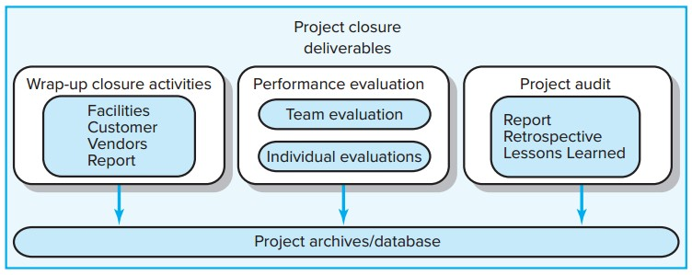
Project Closure and Review Deliverables

Slide 4
Major Tasks of Project Closure
Evaluate if the project delivered the expected benefits to all stakeholders.
– Was the project managed well?
– Was the customer satisfied?
Assess what was done wrong and what contributed to successes.
Identify changes to improve the delivery of future projects.

Slide 5




Project Closure
Types of Project Closure
  Normal
  Premature
  Perpetual
  Failed Project
  Changed Priority
Close-out Plan:
Questions to be Asked
  W hat tasks are required to close the project?
  W ho will be responsible for these tasks?
  W hen will closure begin and end?
  How will the project be delivered?

Slide 6
Types of Project Closure
Normal:
  The most common circumstance for project closure is simply a completed project.
Premature:
  For a few projects, the project may be completed early with some parts of the project eliminated, say an early requirement.
Perpetual:
  Some projects never seem to end. The major characteristic of this kind of project is constant “add-ons,” suggesting a poorly conceived project scope. At some point the review group should recommend methods for bringing final closure to this type of project or the initiation of another project.
Failed Project
Changed Priority:
  Organizations’ priorities often change and strategy shifts directions.

Slide 7
Wrap-up Closure Activities
Getting delivery acceptance from the customer.
Shutting down resources and releasing to new uses.
Reassigning project team members.
Closing accounts and seeing all bills are paid.
Delivering the project to the customer.
Creating a final report.

Slide 8
Project Audits: Creating the Final Report
Executive Summary
–Project goals met/unmet
–Stakeholder satisfaction with
project
–User reactions to quality of
deliverables
Analysis
–Project mission and objective
–Procedures and systems
used
–Organization resources used
Recommendations
–Technical improvements
–Corrective actions
Lessons Learned
–Reminders
–Retrospectives
Appendix
–Backup data
–Critical information

Slide 9

Project Audits: Lessons Learned, Retrospectives & Barriers to Organizational Learning
Lessons Learned
  An analysis carried out during and shortly after the project life cycle to capture positive and negative project learning—“what worked and what didn’t?”
Goals of Retrospectives
  To reuse learned solutions
  To stop repetitive mistakes
Barriers to Organizational Learning
  Lack of post-project time for developing lessons
  No post-project direction or support for teams
  Lessons become blame sessions
  Lessons are not applied in other locations
  Organizational culture does not recognize value of learning

Slide 10
THANKS

Slide 11

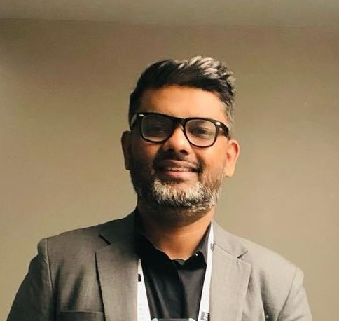
Guest Speaker Profile
Mr. Sheriff Izhar. He accumulated a wealth of experience over the course of 15 years in the software industry, specifically in project management.
For the past 9 years, he has been associated with a company called Northstar Technologies, where he have been able to hone his skills and contribute to the growth of the organization.
He’s educational background includes a bachelor's and master's degree in accounting and finance from PAF KIET, as well as a master's degree in project management from Bahria University. Additionally, He has also earned a master's degree in strategic business management from a university in the UK.
Enhancing his expertise in the field .Throughout his career, He had the opportunity to work on diverse projects across different regions. From a project management perspective, he has successfully implemented initiatives in the United States, United Kingdom, GCC region, Singapore, and Australia. These experiences have not only broadened his skillset but have also allowed him to gain valuable insights into international business practices .For the past 5 years, He has entrusted with the leadership of the project management division within his company. In this role, He has taken on the responsibility of implementing an Enterprise Resource Planning (ERP) system and a club management software in the UK and AU regions. Managing a portfolio valued at approximately 2.8 million dollars.

